Slide 1
Taboola project
By Koren Gast

Slide 2
Question #1.1 - Creativity and modeling: Different ways to identify users
Q #1.1

Slide 3
Phase 1 – URL segmentation
Q #1.1
Create a pool of labeled URLs
Existing pools
Resources allocation
Outsourcing
Vector representation of URL
Normalized word count
TF-IDF alike
Supervised classification
Logistic regression
Random forest

Slide 4
Phase 2 – Location segmentation
Q #1.1
Home – Most common location in after work hours (local time)
Work – Most common location in work hours (local time)
Other – Others…

Slide 5
Phase 3(#1) – Job searchers
Q #1.1
URL:
Increase in page views classified as “Job searching”
Decrease in page views classified as “Academic” (Another URL class is needed)
Location:
Home == work
Significant increase in “other” and decrease in “work”

Slide 6
Phase 3(#2) – Sport enthusiasts
Q #1.1
URL:
Average periodic numbers of “Sports” page views
URL + Time:
Average periodic duration in “Sports”

Slide 7
Phase 3(#3) – House buyers
Q #1.1
URL:
Increase in page views classified as “Real estate”
Increase in page views classified as “Mortgage”

Slide 8
Question #1.2 - Creativity and modeling: Developing a model start to finish
Q #1.2

Slide 9
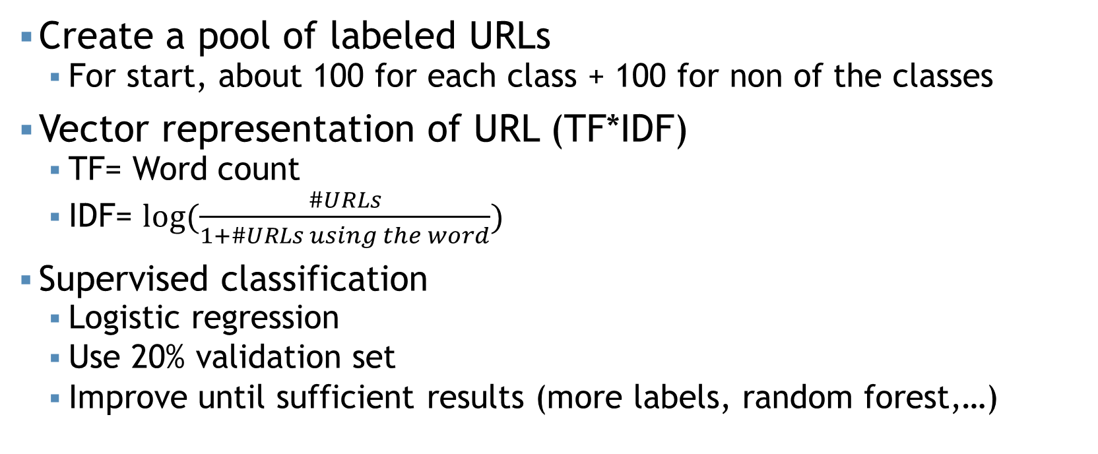
Phase 1 – URL segmentation
Q #1.2
Create a pool of labeled URLs
For start, about 100 for each class + 100 for non of the classes
Vector representation of URL (TF*IDF)
TF= Word count
IDF= $log⁡(\frac{\#URLs}{1+\#URLs using the word})$
Supervised classification
Logistic regression
Use 20% validation set
Improve until sufficient results (more labels, random forest,…)

Slide 10
Phase 2 – Location segmentation
Q #1.2
For each user:
The most common location in 20:00 – 08:00 = Home
The most common location in 10:00 – 17:00 = Work
If there is a major change in a long period, update (home\work changed)

Slide 11
Phase 3 – Features creation
Q #1.2
From “user matrix” to “user vector”:
Temporal features:
Average periodic (daily\weekly\monthly\yearly) platform (tablet\laptop\pc\smartphone) use for class (sports\job search\home buying\other)
Ratio between current period(daily\…) time spent in sports\... and last period
User ID | Time start | Time end | Location | URL segmentation | Platform
1 | 17/06/18 21:21:21 | 17/06/18 22:22:22 | Home | Sports | Tablet
1 | 18/06/18 10:10:10 | 18/06/18 11:11:11 | Work | Other | PC
… | … | … | … | … | …
1 | 18/12/18 14:14:14 | 18/12/18 14:41:00 | Work | Sports | Smartphone
2 | … | .. | … | … | …
… | … | … | … | … | …

Slide 12
Phase 4 – Clustering
Q #1.2
Using unsupervised learning for clustering the users (K-means)
4 clusters would (hopefully) represent:
Job searchers
Sport enthusiasts
Home buyers
None of the above
Check some close to center users – are they typical?

Slide 13
Phase 5 – Test the model
Q #1.2
*Assumption: Job searchers are more likely to click on a job search ad
A/B test for #clicks
Chi-square test for statistical signification

Slide 14
Question #2 – Statistical analysis and inference
Q #2

Slide 15
The idea
Q #2
Segments data
Total data
campaign_id | segment_id | d | d_segment_views | d_segment_clicks
1322667 | 112018 | 9/10/2018 | 2433 | 3
1169495 | 85341 | 8/28/2018 | 17175 | 70
1169495 | 85341 | 9/7/2018 | 53325 | 185
1169495 | 85341 | 9/17/2018 | 379715 | 260
1191726 | 1517 | 9/8/2018 | 684 | 0
1191726 | 1517 | 9/18/2018 | 312 | 3
1278666 | 19068 | 9/11/2018 | 560 | 5
1278666 | 19068 | 9/21/2018 | 3495 | 20
1321849 | 123012 | 8/29/2018 | 9272 | 53
1352598 | 19070 | 8/30/2018 | 732 | 9
campaign_id | d | d_campaign_views | d_campaign_clicks
743967 | 9/8/2018 | 4060923 | 6999
650050 | 9/9/2018 | 2964025 | 7835
650050 | 9/19/2018 | 3079815 | 11420
728856 | 9/21/2018 | 639880 | 6404
267746 | 9/19/2018 | 17819685 | 30513
1209775 | 9/8/2018 | 1622235 | 6885
541312 | 9/9/2018 | 2791578 | 3264
1318242 | 9/17/2018 | 2762343 | 7065
1283051 | 8/31/2018 | 1698996 | 4176
1159116 | 9/3/2018 | 81970857 | 27525
clicks_ratio = clicks/views

Slide 16
The idea
Q #2
Segments data
Total data
campaign_id | segment_id | d | d_segment_cliks_ratio
1322667 | 112018 | 9/10/2018 | 0.001233
1169495 | 85341 | 8/28/2018 | 0.004076
1169495 | 85341 | 9/7/2018 | 0.003469
1169495 | 85341 | 9/17/2018 | 0.000685
1191726 | 1517 | 9/8/2018 | 0
1191726 | 1517 | 9/18/2018 | 0.009615
1278666 | 19068 | 9/11/2018 | 0.008929
1278666 | 19068 | 9/21/2018 | 0.005722
1321849 | 123012 | 8/29/2018 | 0.005716
1352598 | 19070 | 8/30/2018 | 0.012295
campaign_id | d | d_campaign_clicks_ratio
743967 | 9/8/2018 | 0.001723
650050 | 9/9/2018 | 0.002643
650050 | 9/19/2018 | 0.003708
728856 | 9/21/2018 | 0.010008
267746 | 9/19/2018 | 0.001712
1209775 | 9/8/2018 | 0.004244
541312 | 9/9/2018 | 0.001169
1318242 | 9/17/2018 | 0.002558
1283051 | 8/31/2018 | 0.002458
1159116 | 9/3/2018 | 0.000336
clicks_ratio = clicks/views

Slide 17
The idea
Q #2
Segments data
Total data
campaign_id | segment_id | d | d_segment_cliks_ratio | Clicks_rate
1322667 | 112018 | 9/10/2018 | 0.001233 | 0.715431
1169495 | 85341 | 8/28/2018 | 0.004076 | 1.541857
1169495 | 85341 | 9/7/2018 | 0.003469 | 0.93562
1169495 | 85341 | 9/17/2018 | 0.000685 | 0.068417
1191726 | 1517 | 9/8/2018 | 0 | 0
1191726 | 1517 | 9/18/2018 | 0.009615 | 2.265565
1278666 | 19068 | 9/11/2018 | 0.008929 | 7.636276
1278666 | 19068 | 9/21/2018 | 0.005722 | 2.237424
1321849 | 123012 | 8/29/2018 | 0.005716 | 2.325596
1352598 | 19070 | 8/30/2018 | 0.012295 | 36.61538
campaign_id | d | d_campaign_clicks_ratio
743967 | 9/8/2018 | 0.001723
650050 | 9/9/2018 | 0.002643
650050 | 9/19/2018 | 0.003708
728856 | 9/21/2018 | 0.010008
267746 | 9/19/2018 | 0.001712
1209775 | 9/8/2018 | 0.004244
541312 | 9/9/2018 | 0.001169
1318242 | 9/17/2018 | 0.002558
1283051 | 8/31/2018 | 0.002458
1159116 | 9/3/2018 | 0.000336
clicks_rate = segment_clicks_ratio/campaign_clicks_ratio (where campaign_id=campaign_id & d=d)

Slide 18
The idea
Q #2
Segments data
campaign_id | segment_id | clicks_rate
1322667 | 112018 | 0.715431
1169495 | 85341 | 2.546
1191726 | 1517 | 2.265565
1278666 | 19068 | 9.873
1321849 | 123012 | 2.325596
1352598 | 19070 | 36.61538
segments.groupby([campaign_id, segment_id])[clicks_rate].sum()

Slide 19
Problems and solutions
Q #2
Expected:
segments.groupby([campaign, d])[#views].sum()==total[campaign, d][#views]
segments[campaign, d, segment][#views]>0,
however total[campaign, d][#views]=0
Solution: calculate the “Total”

Slide 20
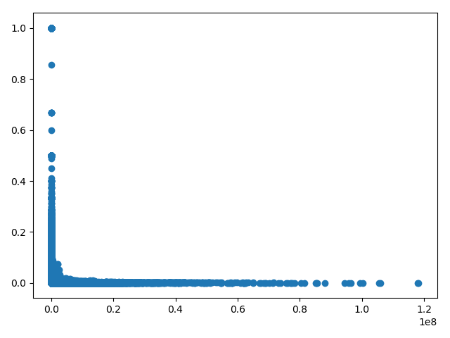
Problems and solutions
Q #2
Unproportional clicsks_ratio
Clicks_ratio
# views

Slide 21
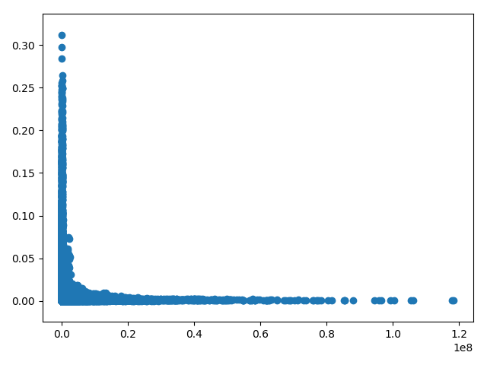
Problems and solutions
Q #2
Unproportional clicsks_ratio
#views>median(views)
Clicks_ratio
Clicks_ratio
# views
# views

Slide 22
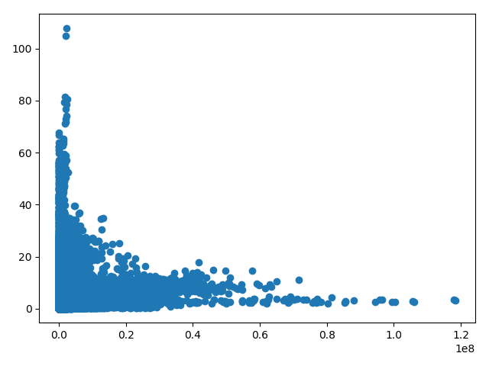
Problems and solutions
Q #2
Solution: clicks_ratio = clicks/sqrt(views)
Using only #views>=percentile(views, 25) (=about 1200 views)
Clicks_ratio
# views

Slide 23
Problems and solutions
Q #2
When using clicks_ratio = clicks/sqrt(views), the average views of the best 100 is about 10 times bigger than the total average
Solution: Go back to use clicks_ratio = clicks/views
than the average views of the best 100 is about 65% from the total average

Slide 24
To sum up
Q #2
Step 1: Read the segments data and calculate clicks_ratio(=clicks/views)
Step 2: Create the “total” table using groupby
Step 3: Calculate click_rate(=segment_click_ratio/total_click_ratio)
Step 4: Groupby along the dates and sort

